Slide 1
Compassion for the Earth

Slide 2
Day 1 slides

Slide 3
What actions in this story show compassion?
Read the story-
The Woman Who Lived with the Wolves
Turn and Talk:
Share the actions in the story that show compassion.
Hook

Slide 4
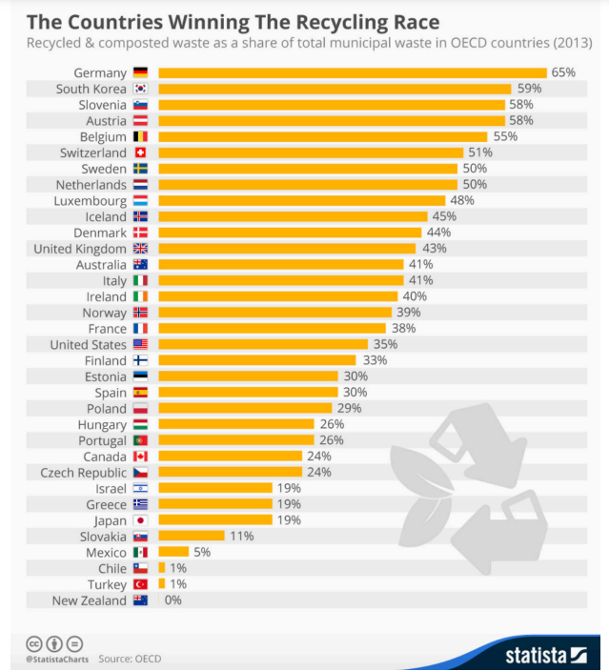
What do you notice? What do you wonder? What questions may have been asked to collect this data?
Engage
Notes:
Youcubed Data Talk Recycling Race
This graph shows which countries have proven most successful in reducing waste through effective recycling. What does recycling mean to you? Can you think of ways you and your community can help boost your country’s environmental commitment? For more information about Data Science and Data Talks, and advice on ways to implement data talks, go to https://www.youcubed.org/resource/data-talks/
https://www.statista.com/chart/4470/the-countries-winning-the-recycling-race/
Copyright © 2020 youcubed. All rights reserved.

Slide 5
Your Task
You will be assigned a new data set.
Work with your team to:
Explore a new data set.
As you explore this data, think about these questions:
What do you notice about this new data set? What do you wonder about?
What questions do you think were asked when collecting this data?
What story does this data tell you?
Does your data show compassion? If yes, how does the data show this?
You will present your data and tell the data story at the end of class.
Explore and Explain

Slide 6
Closure- team share
What are the stories data tell?
Do these stories show acts of compassion?
Closure

Slide 7
Day 2 slides

Slide 8
What actions in this story show respect?
Read the story-
The Mysterious Butte
Turn and Talk:
Share the actions in the story that show respect.
Hook 1

Slide 9
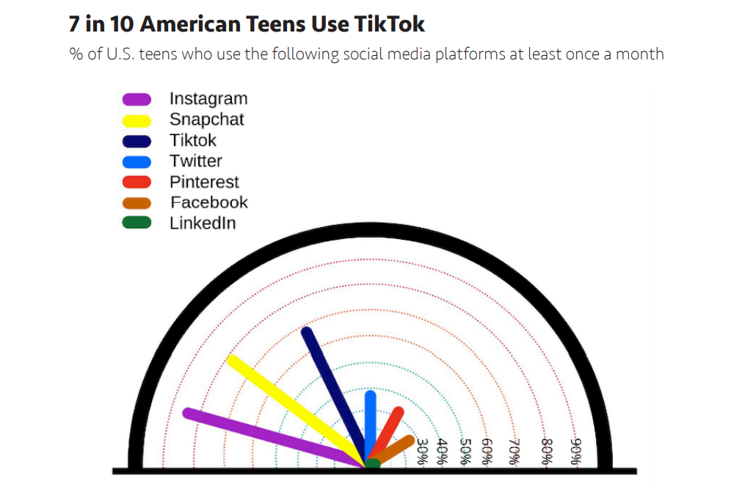
What do you notice? What do you wonder? What question (or questions) was asked to collect this data?
Hook 2
Notes:
Youcubed Data Talk Recycling Race
This graph shows which countries have proven most successful in reducing waste through effective recycling. What does recycling mean to you? Can you think of ways you and your community can help boost your country’s environmental commitment? For more information about Data Science and Data Talks, and advice on ways to implement data talks, go to https://www.youcubed.org/resource/data-talks/
https://www.statista.com/chart/4470/the-countries-winning-the-recycling-race/
Copyright © 2020 youcubed. All rights reserved.

Slide 10
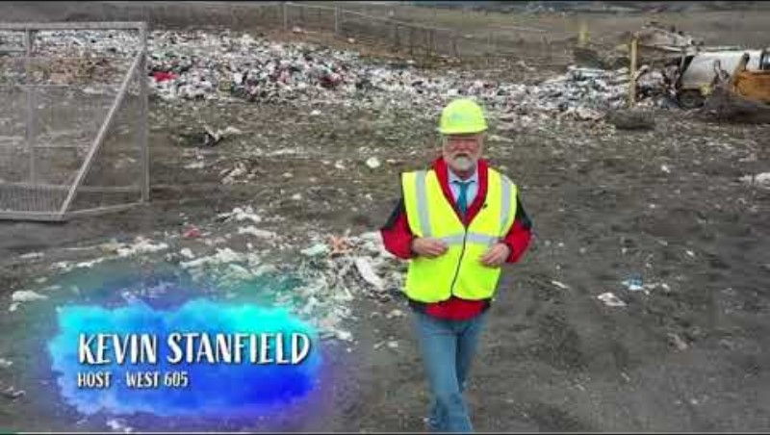
What do you notice? What do you wonder about?
Explore

Slide 11
Table talk
What do you throw away at lunch?
Explore and Explain

Slide 12
Your Task
What do you throw away at lunch?
Work with your team to:
Build the amount of trash you throw away at lunch.
Find the volume of your trash.
Explore

Slide 13
Finding Volume
How do you find the volume of the prisms?
6 in
2 in
6 in
4 in
4 in
11 in
4 in
7 in
12 in
Explore

Slide 14
Class data
Team number | 1 | 2 | 3 | 4 | 5 | 6
Volume in cubic inches
Explain

Slide 15
Closure- Table talk and share
How can we use our class data to predict how much data we throw away at lunch as a school?
Closure

Slide 16
Day 3 slides

Slide 17
How can we find the class average of volume of trash?
Class data:
Team number | 1 | 2 | 3 | 4 | 5 | 6
Volume in cubic inches
Hook

Slide 18

What do you notice? What do you wonder about?
Explore

Slide 19
How can we make predictions?
Your task:
Work with your team to predict the volume and weight of the lunch trash created in our school in one week.
Make a plan:
What information do you already know?
What smaller pieces of information do you need to know to be able to make predictions to solve this problem?
Create a plan to answer these questions on a poster.
When your team plan is complete, get approval to gain the information you need.
Explore

Slide 20
Demonstrate your predictions
On a poster show the predictions you made to solve the question:
How much volume and weight of lunch trash is created in our school in one week?
Explain/Closure

Slide 21
Day 4 slides

Slide 22
Trash reflection
Take a few moments to reflect and respond to these questions about the lunch trash in our school.
How many bags of trash are thrown away in one week?
What could we do as a school to reduce trash?
Why is it important to reduce trash?
Hook

Slide 23
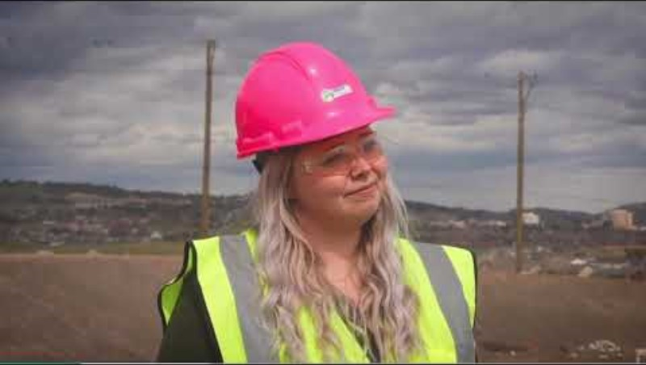
Act 3
What do you notice?
What do you wonder?
What types of jobs do you think a sustainability coordinator does?
Explore

Slide 24
Create a data story
Your task-
You are taking on the role of the school sustainability coordinator.
You need to use the data we collected this week to create a data display to tell the story of the school lunch trash AND convince your peers and others to throw away less trash.
Make sure the data display you create is clear, makes sense to local leaders to demonstrate how positive changes need to be made to create a healthier environment and show more compassion and respect to the Earth.
Explain

Slide 25
Share your data display
Your will now share your data story with your classmates.
How does your display show trash thrown away?
How does your display show why it is important to show compassion to our planet?
How does your display convince others to make positive changes?
Explore

