Slide 1
Resilient Designs
adapted from the the lesson “3, 2, 1…Natural Disaster”
by the Oak Ridge Institute for Science and Education

Slide 2
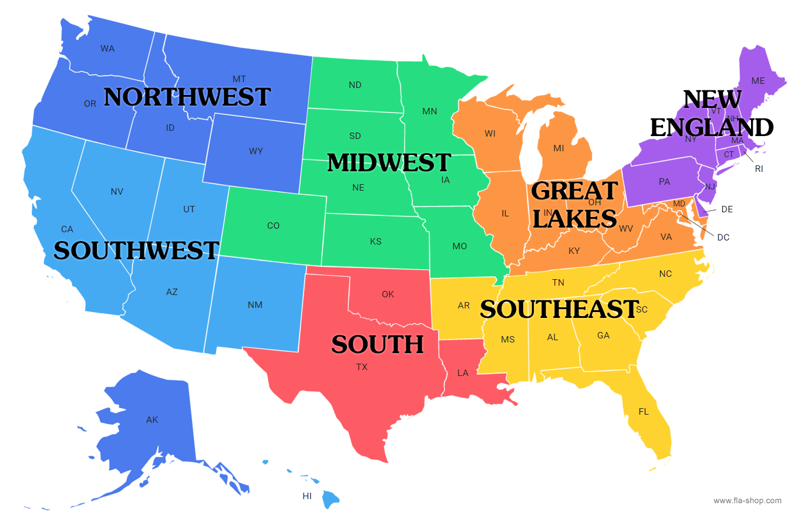
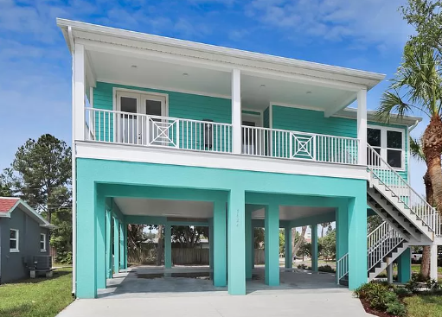
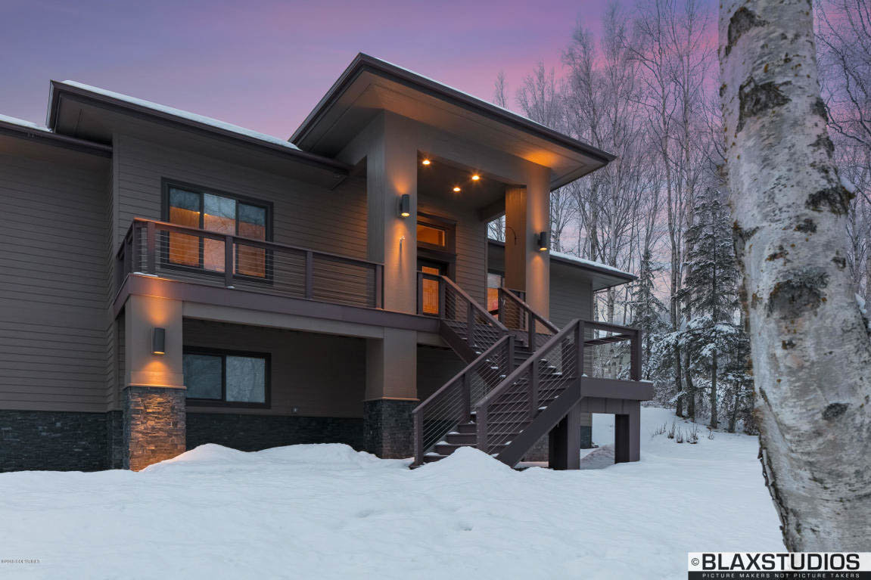
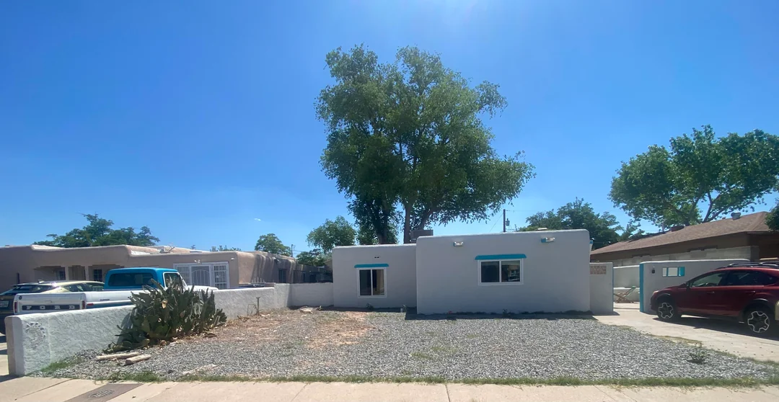
Day 1 Warm up
With your partner/team decide what region of the United States you think each of the houses pictured may be found. Why here?

Slide 3
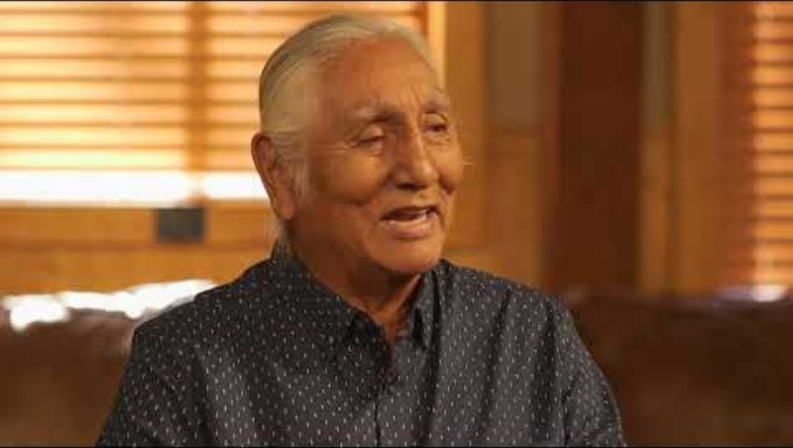
FORTITUDE – WOWAČÍŊTAŊKA

Slide 4
FORTITUDE – WOWAČÍŊTAŊKA
Fortitude means facing danger or challenges with courage, strength, and confidence. Believing in oneself allows a person to face challenges. Fortitude includes the ability to come to terms with problems, accept them, and to find a solution that is good for everyone.
from Lakota Value Akta Lakota St. Joseph Indian School

Slide 5
What is standing out to you as you read this?
What actions do you connect with fortitude?
What connections can you make with your own life?
FORTITUDE – WOWAČÍŊTAŊKA
Fortitude means facing danger or challenges with courage, strength, and confidence. Believing in oneself allows a person to face challenges. Fortitude includes the ability to come to terms with problems, accept them, and to find a solution that is good for everyone.
from Lakota Value Akta Lakota
Cultural Center

Slide 6
Meteorology Report
Read your team’s meteorology report for your region.
Think about the impact the severe weather event in your region has on shelters.
Discuss as a group:
What causes the event’s speed, size and duration?
What impact would it have on shelters?
Notes:
Share the scenario and hand out meteorology reports to each team.

Slide 7
Connection to WOWAČÍŊTAŊKA
Why would wowačiŋtaŋka (fortitude) be important when communities face difficult weather events, such as floods, blizzards or tornadoes?
How does working together to solve problems help a community stay strong?

Slide 8
Your Task
Your job is to work as a team of engineers and architects to build a shelter that can withstand the extreme weather in your region.
Your goal is to design a shelter that provides the most protection possible from your extreme weather event.
Notes:
Hand out Building Task Cards
Review constraints.
Share Testing Procedures.

Slide 9
Your Task- Design
Look at the building supplies available to you.
Work with your team to create a plan for your shelter design. Draw your plan on poster paper.
When you have completed your plan, call on the building inspector (teacher) for approval to begin building.
Notes:
Students may not start building at this point- They first need to get approval for their design from the teacher.

Slide 10
Day 1 Closing
FORTITUDE – WOWAČÍŊTAŊKA
Fortitude means facing danger or challenges with courage, strength, and confidence. Believing in oneself allows a person to face challenges. Fortitude includes the ability to come to terms with problems, accept them, and to find a solution that is good for everyone.
from Lakota Value Akta Lakota
Cultural Center
Revisit the quote about Fortitude.
Reflect and respond:
What actions could you show if you were faced with your assigned weather event?
My weather event is:
To show fortitude and find a solution to my problem that is good for everyone in my family and community I would…

Slide 11
Day 1 Closing
What are other Oceti Sakowin values/virtues you practiced today?
How did you show/demonstrate these values?
Examples to choose from:
Gathers one strength, be industrious and make an effort- Bdiheiciya
Bravery and Courage- Woohitika
Compassion and Kindness- Wowaunila
Wisdom- Woksape
Generosity- Wowachantognake
I demonstrated:
I demonstrated this value when…

Slide 12
Day 2 Warm up
Today you will build your resilient home!
Which Oceti Sakowin values/virtues will you focus on today to help your team build a successful home?
How will you show/demonstrate these values?
Examples to choose from:
Gathers one strength, be industrious and make an effort- Bdiheiciya
Bravery and Courage- Woohitika
Compassion and Kindness- Wowaunila
Wisdom- Woksape
Generosity- Wowachantognake
I will show:
I will show this value by…

Slide 13
Before we build come up with a plan…
Talk with your team to decide how you will be sure everyone has a role in building today.
Which team members will help to get materials? AND How will every team member help in building?
If the building inspector notices that there only one team member had taken over the project and that there are team members not helping, your team could get a warning or permit (time out for building).
Work together to create a plan so that everyone has an active role.

Slide 14
Day 2 Be INNOVATIVE!
Watch this video about the homes being built in Pine Ridge, South Dakota.
Where do you see examples of:
The people in the video showing respect to place and environment?
Communities working together to promote the Oceti Sakowin way of life?
Strategies used by leaders to improve the gifts of the Oceti Sakowin people?
Wisdom, Innovation, Ambition, Compassion, Respect… Other Oceti Sakowin values and virtues?
Notes:
Hand out these questions to students before they watch the video.

Slide 15

Notes:
Hand out these questions to students before they watch the video.

Slide 16
Day 2 Be INNOVATIVE!
Share at tables/with a partner.
Where did you see examples of:
The people in the video showing respect to place and environment?
Communities working together to promote the Oceti Sakowin way of life?
Strategies used by leaders to improve the gifts of the Oceti Sakowin people?
Wisdom, Innovation, Ambition, Compassion, Respect… Other Oceti Sakowin values and virtues?
Notes:
Hand out these questions to students before they watch the video.

Slide 17
Build your shelter!
Remember, your shelter must…
be attached to the 6-inch by 6-inch base and the shelter base can not exceed this 6-inch by 6-inch area;
stand on its own (i.e., no holding, leaning on wall, etc.);
measure between 4 and 10 inches high;
have an entrance/exit and some type of ventilation.

Slide 18
Let’s travel!
Identify one person from your team to be the “traveler.” The traveler is the person that most recently traveled out of state.
The traveler checks in with each of the other teams for ideas and reports back to their home team. Travelers may ask questions about the materials, their purpose and any building challenges.

Slide 19
Day 2 Closing- Exit Ticket
The Oceti Sakowin Essential Understanding 7.4 states:
Use Oceti Sakowin philosophy to problem solve concepts and tackle unfamiliar problems.
What were three ways you helped your team problem solve the planning and/or construction of your home?
I helped to plan the…
I helped to get…
I helped to build these sections…

Slide 20
Day 3 Warm up
We started this lesson the first day thinking about the value, Fortitude.
What are some other words that come to mind when you think about Fortitude?
Think about the weather event you were assigned and the home you designed and how your team worked together. What are the ways you worked together to practice FORTITUDE and the other words you thought about.

Slide 21
Day 3 Warm up
Today you will test your homes resilience!
Please gather your home to your workstation.
After all your team members have arrived, please reread your testing procedure.
Please decide as a group what materials you need for your test.
You will not gather these materials yet!

Slide 22
Gather your testing materials and prepare your presentation
When you have the go ahead from the building inspector (your teacher) you and your team can work together to gather your materials.
We will be testing as a class- DO NOT TEST YOUR HOME UNTIL YOU ARE GIVEN PERMISSION! ☺
Use this time to work with your team to determine what you will share about your weather event, your design plan, the house you constructed AND your testing procedure.

Slide 23
Let’s Share Our Designs!

Slide 24
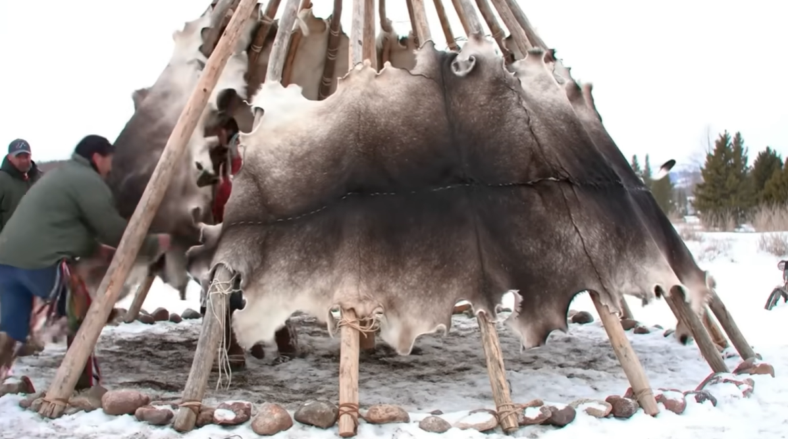
Blizzard

Slide 25
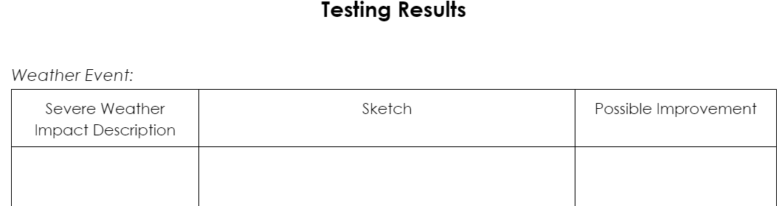
Test your shelter!
Follow the testing procedure task card for your weather event.
Each team member records observations on the Testing Results chart.

Slide 26
Way of Life
Why do people choose to live where they live?
Why is it important to have a strong community and to support our community?
What does it look like, sound like, feel like to demonstrate the Oceti Sakowin values that promote community and positive way of life?

Slide 27
Fortitude
Wowačhíŋtȟaŋka — Fortitude
The Lakota word for fortitude, means facing danger or challenges with courage, strength and confidence. Believing in oneself allows a person to face challenges. Fortitude includes the ability to come to terms with problems, to accept them and to find a solution that is good for everyone.
Historically, one of the first lessons a Lakota child learned was self-control and self-restraint in the presence of parents or adults. Mastery and abilities came from games and creative play. Someone more skilled than oneself was viewed as a role model, not as a competitor. Striving was for achieving a personal goal, not for being superior to one's opponent. Success was a possession of the many, not of the few.
-Akta Lakota Cultural Center website
Return to your reflection on Fortitude from Day 1 of this lesson.
Read your reflection from Day 1.
Take a little time to read the rest of the Fortitude quote.

Slide 28
Quotes from Joseph M. Marshall
Read the quotes from Joseph Marshall.
After your new learning, what other thoughts do you have about fortitude, resilience, and problem-solving? Have they changed?
Add any new thoughts to your reflection from day 1.
The allied people thrived for several generations because of one significant factor: their willingness and ability to adapt. That enabled them to assess any new environment or situation and ascertain what was necessary to survive within it or with it.
Hundreds of years ago our ancestors migrated to the northern Plains and learned to survive in a difficult, even harsh and unforgiving environment where others had not. They survived because they did not fight the environment. They survived because they understood the realities of it and accepted the limitations it placed on them. Within that balance, they became a strong people.
-by Joseph M. Marshall
From To You We Shall Return: Lessons About Our Planet from the Lakota

